Slide 2
C Programming Language

Slide 3
UNIT 1
PROCESS OF PROGRAMMING

Slide 4
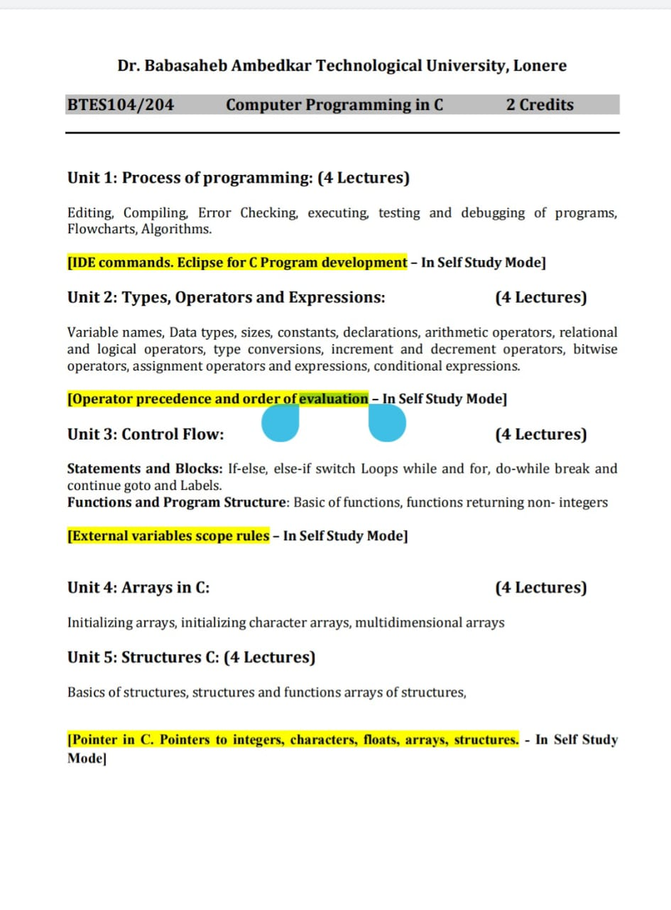

Slide 5
Why we need a Programming language
For e.g.,
an activity like send greeting card
It will contain small steps like go to the greeting card shop, choose it, pay for it, write the names and address, go to the post office, buy stamps, affix the stamps and drop the card in the post drop box.
In this some steps like going to the post office, buying stamps and dropping the card in the post box are time-consuming and repetitive

Slide 6
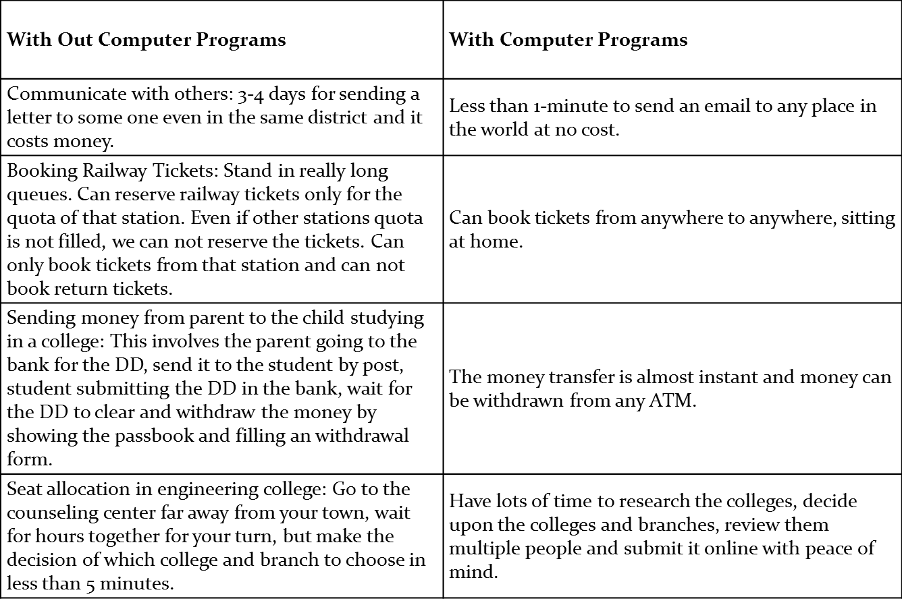
Computer Programs

Slide 7
Computer System
Computer is basically a group of electronic devices that can accept data, conduct a series of arithmetic and logical operations on it and give result of these operations as information that is useful to people.
A computer system consists of two major components, namely, hardware and software.
All physical components that forms computer system are known as computer hardware.
Software is basically collection of different programs that tells computer’s hardware what to do.

Slide 8
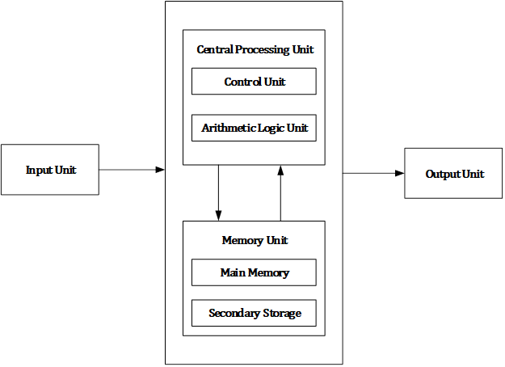
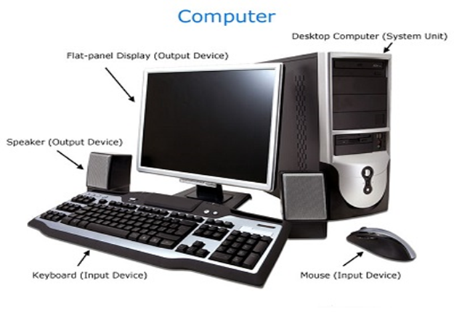
Computer Block Diagram

Slide 9
Introduction to Computer
Computer is basically a group of electronic devices that can accept data, conduct a series of arithmetic and logical operations on it and give result of these operations as information that is useful to people.
All the modern computers are digital and represents information in binary digits. They represent data using two distinct values.
In binary system we have only two digits (bits) – 0 and 1 to represent data. Since the bit is a very small unit, virtually, it cannot convey much information while used single.
Combination of eight bits is called a byte. A byte is the fundamental unit of data representation in computer. A byte can represent one character of data. Modern computers are capable of processing more than one byte at a time.

Slide 10
Programming Languages
Programming languages are the basic building blocks for all software, allowing people to tell computers what to do and the means by which software are developed.
A programming language is a formal computer language designed to communicate instruction to a machine, particularly a computer.
A programming language or computer language is a standardized communication technique for expressing instructions to a computer.
To communicate with computer, we need to use language which computer can understand and process i.e. programs should be written in computer understandable languages called programming languages.
Programming language consists of a set of characters, symbols and set of rules known as syntax rule. Programmer has to follow all specified rules strictly to get desired results.
In general, programming language is a set of syntactic and semantic rules used to define computer programs.

Slide 11
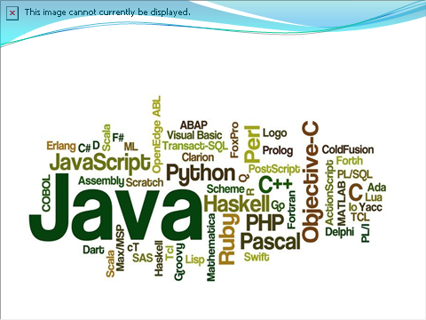

Slide 12
What is Program?
Definition:-
A computer program is a collection of data and instructions that can be executed by a computer to perform a specific task.
A computer program is a collection of instructions that performs a specific task when executed by a computer.
A computer program is usually written by a computer programmer in a programming language
A computer program is a list of instructions that tell a computer what to do
A computer requires programs to function, and typically executes the program's instructions in a central processing unit.

Slide 13

History of c language
C programming language was developed in 1972 by Dennis Ritchie at bell laboratories of AT&T(American Telephone & Telegraph), located in U.S.A.
Dennis Ritchie is known as founder of c language.
It was developed to be used in UNIX Operating system.
It inherits many features of previous languages such as B and BPCL.

Slide 14
History of c programming
Language | year | Developed By
ALGOL | 1960 | International Group
BPCL | 1967 | Martin Richards
B | 1970 | Ken Thompson
Traditional C | 1972 | Dennis Ritchie
K & R C | 1978 | Kernighan & Dennis Ritchie
ANSI C | 1989 | ANSI Committee
ANSI/ISO C | 1990 | ISO Committee
C99 | 1999 | Standardization Committee

Slide 15
Features of C Language
C is the widely used language. It provides many features that are given below.
Simple
Machine Independent or Portable
Mid-level programming language
structured programming language
Rich Library
Memory Management
Fast Speed
Pointers
Recursion
Extensible

Slide 16
System vs Application Software
Set of computer programs that are designed to control computer hardware and to provide service.
Computer program that is designed to perform specific task.
System software manages computer resources and provides platform for the execution of application software.
Application software manages their specific tasks to suit their needs.
System software can exist as a lone entity.
Application software needs system software for its existence.
Examples: MS Windows, Mac OS, Unix, Linux etc.
Examples: Web browsers, Word processor, Image Editors, Spreadsheets etc.

Slide 17
Computer Programming Language

Slide 18
High Level Language(HLL)
A HLL is a programming language which enables a normal human being like us to write programs that helps he computer to perform any of the required instruction task.
It is easy to understand, read and write.
It is programmer friendly language, so computer can’t understood.
It needs compiler or interpreter for translation.
To make computer understand it first convert it into assembly language then into machine language .
It is portable.

Slide 19

High Level Language(HLL)

Slide 20
Advantage of High Level Language
High level language has following advantages :
Easy to Use and Understand : High level language uses English like words and they are closer to natural language which makes easy to learn and understand. Programmer need not to understand detailed computer architecture for writing programs using high level language.
Machine Independent : Programs written in high level language are portable and hence program written using high level language can be executed on any type of computer with little or no modification at all.
Debugging is Easy : High level language makes easier to write and debug a program and gives the programmer time to think about overall logic rather than thinking about program code. Because of the use of compilers and interpreters, errors can be detected and located easily.
Easy to Maintain Program : Modification and maintenance of program written in high level language is easy compared low level language.

Slide 21
Disadvantages of High Level Language
High level language has following disadvantages :
Poor Control on Hardware: Since high level languages are away from hardware and programmer does not need to be aware of hardware, accessing and controlling hardware directly is difficult.
Slow Execution: Program written in high level language need to be translated to machine language. This translation process increases the execution time of program.

Slide 22
Medium language / Assembly language
Assembly language is the more than low level and less than high-level language so it is intermediary language.
Assembly language is only understand by human beings not by the computers.
In assembly language data can be represented with the help of mnemonics such as Mov, Add, Sub, End etc.
Assembler is used as translator to convert mnemonics into machine understandable form.
Assembly language is the machine dependent and it is not portable.

Slide 23

Assembly language

Slide 24
Advantages of Assembly Language
Assembly language has following advantages :
Easy to Understand and Use: Assembly language uses mnemonic codes which are easy to use and remember. So, errors which can occur while writing program using assembly language are less as compared to writing program using machine language. Also, assembler provides a way to locate and correct errors.
Speed: Program written in assembly language executes faster than program written high level language.

Slide 25
Disadvantages of Assembly Language
Machine Dependent: Program written in assembly language are machine dependent and hence program developed for one system does not execute on other system.
Difficult to Learn :Since assembly language is machine dependent so every type of computer architecture requires a different assembly language. Programmer need to study and understand different mnemonic code according to the architecture used.
Slow Program Development Time: Developing program in assembly language is slow process as compared to high level language.

Slide 26
Machine Language/Low level Language
It is programming language that deals with a computer’s Hardware.
Machine language is only understand by the computers.
In machine language data only represented with the help of binary format(0s and 1s).
Machine language is very difficult to understand by the human beings.
Machine language is very difficult to memorize so it is not possible to learn the machine language.

Slide 27
Advantage of Machine Language
Machine language has following advantages :
Translation Free : Machine language is the only language that computer understands. Program written in languages other than machine language must be translated to machine language. However, the program written in machine language can be directly executed without any translation.
High Speed : Since program written in machine language need not to be translated and hence conversion time is saved which enables execution of machine language program extremely fast.

Slide 28
Disadvantage of Machine Language
Machine language has following disadvantages :
Machine Dependent : Program written in machine language are machine dependent and hence program developed for one system does not execute on other system.
Complex Language for Programming : Since machine language consists only sequence of 0s and 1s, so it is very difficult for programmer to remember and write each instructions.
Error Prone : While programming using machine language everything need to be expressed in sequence of 0s and 1s which is very tedious task. So errors are frequently occurred while programming using machine language.
Time Consuming : Writing program in machine language is time consuming process.

Slide 29
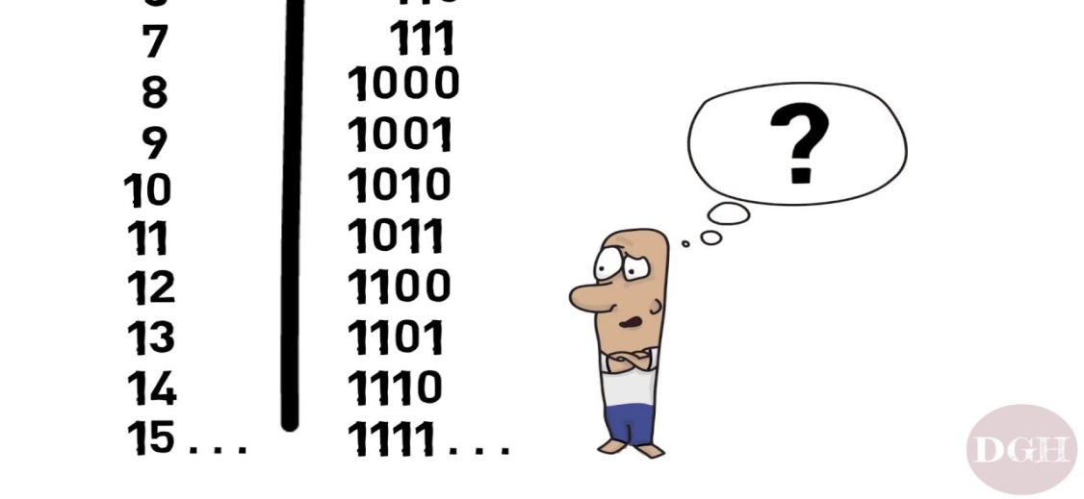
Continue
A binary code represents text, computer processor instructions, or any other data using a two-symbol system. The two-symbol system used is often "0" and "1" from the binary number system.
Binary Language
0 1
Low level high level
signal signal

Slide 30
Algorithm
An algorithm is a set of well-defined instructions in sequence to solve a problem.
Algorithm is a step-by-step procedure, which defines a set of instructions to be executed in a certain order to get the desired output.
It is a step by step procedure that provides solution to given problem.
An Algorithm is a finite set of precise instruction for performing a computational problems.
In algorithm we are using simple English statement as per your convenience.

Slide 31
Algorithm for writing a gmail to xyz person
Step 1: start
Step2: open bowser ,the go to google,& then go to gmail.
Step 3: if I am new user, then I have to create a Gmail account
Step 4: click on login into Gmail account
Step 5: enter your gmail id
Step 6: enter your passward
Step 7: we have to click on sign in buttton.
Step 8: click on compose mail
Step 9: u have to mention the sender mail id,content.
Step 10: click on send button
Step 11: End

Slide 32
Algorithm for writing Gmail
Step 1: start
Step 2: open browser
Step 3: open Google & in that type Gmail sign in
Step 4: if the person is new user ,he/she will create gmail login
Step 5: sign In into gmail
Step 6: enter your gmail id
Step 7: enter your password.
Step 8: click on compose mail
Step 9: write sender mail id & content in write box
Step 10: click on send button.
Step 11: end.

Slide 33
Algorithm for mail in Gmail
Step1-open the chrome or browser.
Step2-Sign into Gmail.
Step3-If new user then create new account in gmail .
Step4-Sign into Gmail.
Step5-Enter the email or phone.
Step6-Enter password.
Step7-click on compose mail.
Step8-write the receiver email_id , subject & data in it
Step9-Send mail.

Slide 34
The following is an algorithm for making a cup of tea.
Step1-Put the teabag in a cup.
Step2-Fill the kettle with water.
Step3-Boil the water in the kettle.
Step4-Pour some of the boiled water into the cup.
Step5-Add milk to the cup.
Step6-Add sugar to the cup.
Step7-Stir the tea.
Step8-Drink the tea.

Slide 35
Write a C program for doing addition of two no
Step 1: start
Step2 :open the c software or turboc
Step 3: taking inputs of 2 no num1 n num2 ,sum
Step 4: adding two no i.e num1 + num2
Store in variable sum=num1 + num2
Step 5: show result sum.
Step 6: End

Slide 36
To Add 2 no
Step 1: Start
Step 2: Declare variables num1, num2 and sum.
Step 3: Read values num1=2 and num2=3.
Step 4: Add num1 and num2 and assign the result to sum. sum←num1+num2
Step 5: Display sum
Step 6: Stop

Slide 37
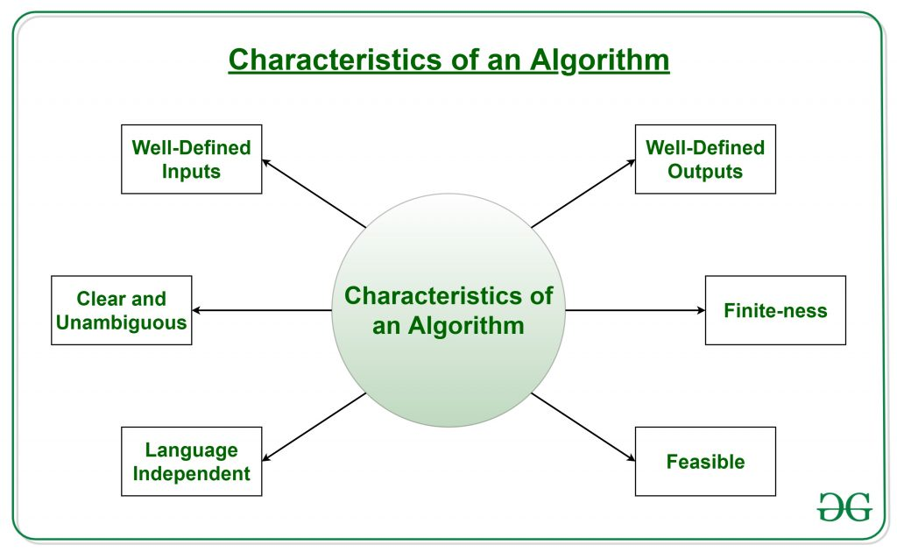
Characteristics of an Algorithm

Slide 38
Characteristics of an Algorithm
Clear and Unambiguous: Algorithm should be clear and unambiguous. Each of its steps should be clear in all aspects and must lead to only one meaning.
Well-Defined Inputs: If an algorithm says to take inputs, it should be well-defined inputs.
Well-Defined Outputs: The algorithm must clearly define what output will be yielded and it should be well-defined as well.
Finite-ness: The algorithm must be finite, i.e. it should not end up in an infinite loops or similar.
Feasible: The algorithm must be simple, generic and practical, such that it can be executed upon will the available resources. It must not contain some future technology, or anything.
Language Independent: The Algorithm designed must be language-independent, i.e. it must be just plain instructions that can be implemented in any language, and yet the output will be same, as expected.

Slide 39
Advantages of Algorithms:
It is easy to understand.
An Algorithm gives a language independent layout of the program or process.
Algorithm is a step-wise representation of a solution to a given problem.
In Algorithm the problem is broken down into smaller pieces or steps hence, it is easier for the programmer to convert it into an actual program.

Slide 40
Disadvantages of Algorithms:
Writing an algorithm takes a long time so it is time-consuming.
Branching and Looping statements are difficult to show in Algorithms.
For large algorithms it becomes difficult to understand the flow of program control.

Slide 41
Flowchart
A pictorial representation of an algorithm is called a Flowchart.
flowchart is a graphical representation that explains the sequence of operations to be performed in order to solve a problem under consideration.
In flowchart, The steps in the algorithm are represented in the form of different shapes of boxes and the logical flow is indicated by interconnecting arrows.
The boxes are used to represent different operations and the arrows are used to repent the sequence of these operations.
Since this is visual way of algorithm representations, it helps the programmer in understanding the logic of the program

Slide 42
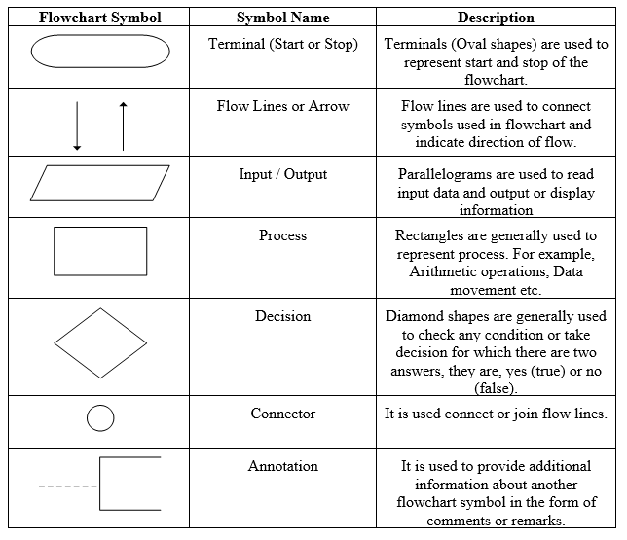
Standard Symbol
:

Slide 43
Rahul
Name of the student
Dob
Address
Mobile no
roll

Slide 44
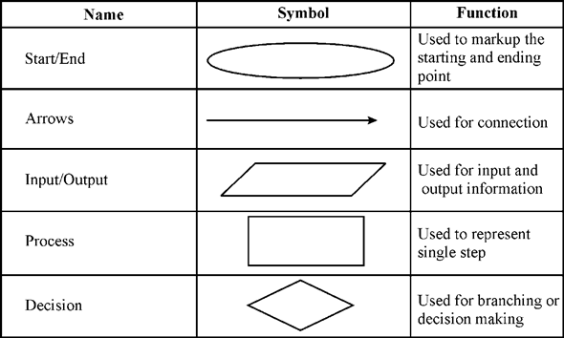
Basic Symbol

Slide 45
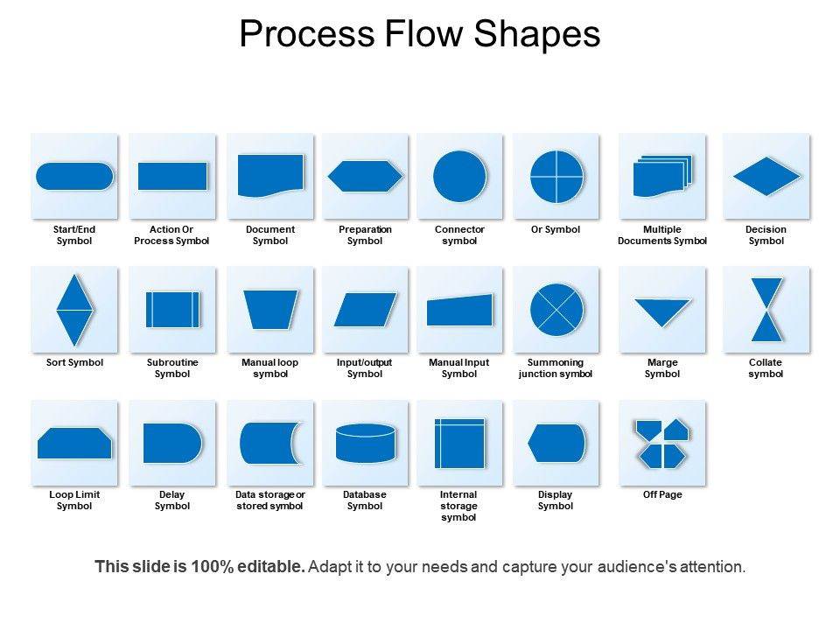

Slide 46
Guidelines for Preparing Flowchart
Following guidelines must be followed while preparing the flowcharts:
Standard symbols should be used while drawing flowchart.
Ensure that flowchart has START (or BEGIN) and STOP (or END).
Flowchart should be neat, clean and easy to follow. There should be no any ambiguity.
The usual direction of flowchart is from top to bottom or from left to right.
The terminal symbol, that is, START/BEGIN or STOP/END should have only one flow line.
Only one flow line should come out from process symbol.
Only one flow line should enter a decision symbol, but two or three flow-lines, one for each possible answer, can leave the decision symbol.
If the flowchart is lengthy and complex connector symbol should be used to reduce the number of flow lines.
Avoid intersection of flow lines.
Use annotation symbol to describe steps more clearly.

Slide 47
Algorithm for Addition of 2 no’s
Step 1: Start
Step 2: Declare variables num1, num2 and sum.
Step 3: Read values num1 and num2.
Step 4: Add num1 and num2 and assign the result to sum. sum←num1+num2
Step 5: Display sum
Step 6: Stop

Slide 48
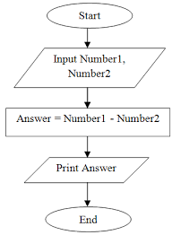
Flowchart for Addition of 2 no’s

Slide 49
Area of circle
Step 1: Start
Step 2: Input read radius r
Step 3: Area=3.14*r*r
Step 4: Display Area
Step 5: Stop

Slide 50
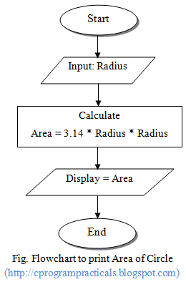
Flowchart for CIRCLE

Slide 51
Algorithm & flowchart that will read the two sides of a rectangle and calculate its area.
Step 1: Start
Step 2: Input width w ,length l
Step 3: Area=w*l
Step 4: Display Area
Step 5: Stop

Slide 52
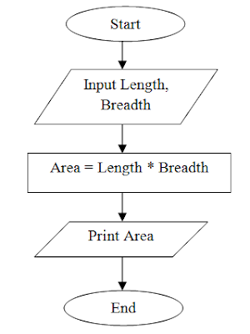
Flowchart for Rectangle

Slide 53
Advantages of Flowchart
Effective Communication : Flowcharts are better way of communicating the logic of the system.
Effective Analysis : Using flowchart problem can be analyzed more efficiently.
Easy Debugging and Efficient Testing : The Flowchart helps in debugging and testing process.
Efficient Coding : The flowcharts are very useful during program development phase.
Proper Documentation : Flowcharts serves as a good program documentation, which is needed for various purpose.
Efficient Program Maintenance : Maintenance of operating programs becomes easy with the help of flowchart.

Slide 54
Disadvantages of Flowchart
Complex Logic: For complicated logic, flowchart becomes complex and clumsy.
Difficulty in Modifications: If change is required in the logic then flowchart needs to be redrawn and requires a lot of time.

Slide 55
Coding (Programming)
In this stage, process of writing actual program takes place.
A coded program is most popularly referred to as a source code.
The coding process can be done in any language (high level and low level).
The actual use of computer takes place in this stage in which the programmer writes a sequence of instructions ready for execution. Coding is also known as programming.

Slide 56
Editing the program
Developing in c program we have to following Steps.
Editing
Compiling
Linking
Executable Files

Slide 57
Editing
Editors or text editors are software programs that enable the user to create and edit text files. In the field of programming, the term editor usually refers to source code editors that include many special features for writing and editing code
Notepad, Wordpad are some of the common editors used on Windows OS and vi, emacs, Jed, pico are the editors on UNIX OS.
Features normally associated with text editors are — moving the cursor, deleting, replacing, pasting, finding, finding and replacing, saving etc.

Slide 58
Types of Editors
There are generally five types of editors as described below:
Line editor: In this, you can only edit one line at a time or an integral number of lines. You cannot have a free-flowing sequence of characters. It will take care of only one line. Ex : Teleprinter, edlin, teco
Stream editors: In this type of editors, the file is treated as continuous flow or sequence of characters instead of line numbers, which means here you can type paragraphs. Ex : Sed editor in UNIX
Screen editors: In this type of editors, the user is able to see the cursor on the screen and can make a copy, cut, paste operation easily. It is very easy to use mouse pointer. Ex : vi, emacs, Notepad
Word Processor: Overcoming the limitations of screen editors, it allows one to use some format to insert images, files, videos, use font, size, style features. It majorly focuses on Natural language.
Structure Editor: Structure editor focuses on programming languages. It provides features to write and edit source code. Ex : Netbeans IDE, gEdit

Slide 59
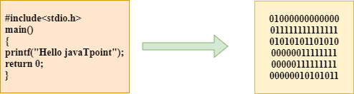
Compilation and Execution Process
What is a compilation?
The compilation is a process of converting the source code into machine code.
It is done with the help of the compiler.
The compiler checks the source code for the syntactical or structural errors, and if the source code is error-free, then it generates the object code/ machine code.
The c compilation process converts the source code taken as input into the object code or machine code

Slide 60
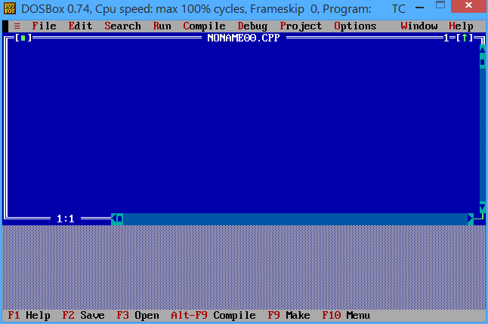
Compilation and Execution Process

Slide 61
Compilation and Execution Process
In an interpreted program, each program statement is converted into machine code before program is executed.
The execution occurs immediately one statement at a time sequentially.
BASIC is one of the frequently used interpreted language.
In contrast to interpreter, a compiler converts a given source code into object code.
Once an object code is obtained, the compiled programs can be faster and more efficient than interpreted programs.

Slide 62
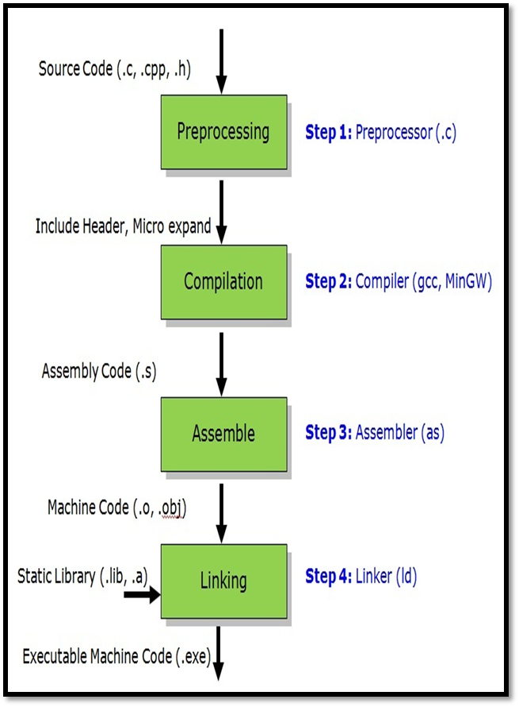
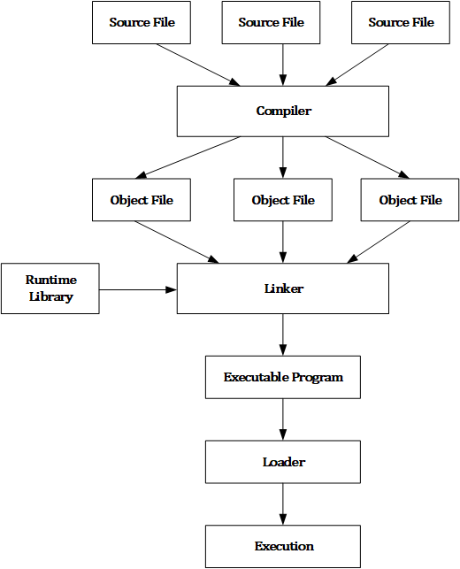
Compilation Process The compilation process can be divided into four steps, i.e., Pre-processing, Compiling, Assembling, and Linking.

Slide 63
Compilation Process
Preprocessor
The source code is the code which is written in a text editor and the source code file is given an extension ".c". This source code is first passed to the preprocessor, and then the preprocessor expands this code. After expanding the code, the expanded code is passed to the compiler.
Compiler
The code which is expanded by the preprocessor is passed to the compiler. The compiler converts this code into assembly code. Or we can say that the C compiler converts the pre-processed code into assembly code.

Slide 64
Compilation Process
Assembler
The assembly code is converted into object code by using an assembler. The name of the object file generated by the assembler is the same as the source file. The extension of the object file in DOS is '.obj,' and in UNIX, the extension is 'o'.
If the name of the source file is 'hello.c', then the name of the object file would be 'hello.obj'.

Slide 65
Compilation Process
Linker
Mainly, all the programs written in C use library functions. These library functions are pre-compiled, and the object code of these library files is stored with '.lib' (or '.a') extension.
The main working of the linker is to combine the object code of library files with the object code of our program.
Sometimes the situation arises when our program refers to the functions defined in other files; then linker plays a very important role in this.
It links the object code of these files to our program.
Therefore, we conclude that the job of the linker is to link the object code of our program with the object code of the library files and other files.
The output of the linker is the executable file.
The name of the executable file is the same as the source file but differs only in their extensions.
In DOS, the extension of the executable file is '.exe', and in UNIX, the executable file can be named as 'a.out'. For example, if we are using printf() function in a program, then the linker adds its associated code in an output file.

Slide 66
Testing
Testing is performed to verify that whether the completed software package functions or works according to the expectations defined by the requirements.
Testing is generally performed by testing team which repetitively executes program with intent to find error.
After testing, list of errors and related information is sent to program developer or development team.

Slide 67
Debugging
Debugging is the process of finding errors and removing them from a computer program, otherwise they will lead to failure of the program.
Even after taking full care during program design and coding, some errors may remain in the program and these errors appear during compilation or linking or execution.
Debugging is generally done by program developer.

Slide 68
Debugging vs Testing
Debugging is the process of fixing errors.
Testing is the process of finding as many errors as possible.
Debugging is done during program development phase.
Testing is done during testing phase which comes after development phase.
Debugging is done by program developer.
Testing is generally carried out by separate testing team rather than program developer.

Slide 69
Error Checking in c
Error is a abnormal condition whenever it occurs execution of the program is stopped..
these are mainly 2 Types of Error in C
Compile Time Error
Run time error
Compile-time and Runtime are the two programming terms used in the software development.
Compile-time is the time at which the source code is converted into an executable code .
The run time is the time at which the executable code is started running. Both the compile-time and runtime refer to different types of error.
Again these errors are divided into 2
Compile Time Error
1. Syntactic Error
2. Semantic Error
Run time error
1.Logical Error
2.Divide by zero

Slide 70
Compile-time errors
Compile-time errors are the errors that occurred when we write the wrong syntax. If we write the wrong syntax or semantics of any programming language, then the compile-time errors will be thrown by the compiler.
The compiler will not allow to run the program until all the errors are removed from the program. When all the errors are removed from the program, then the compiler will generate the executable file.
The compile-time errors can be:
Syntax errors
Semantic errors

Slide 71
Compile-time errors
Syntax errors
When the programmer does not follow the syntax of any programming language, then the compiler will throw the syntax error.
For example,
int a, b:
The above declaration generates the compile-time error as in C, every statement ends with the semicolon, but we put a colon (:) at the end of the statement.

Slide 72
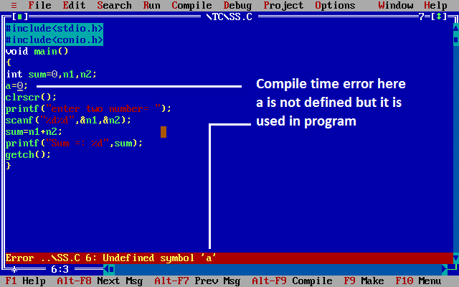
Syntax errors example

Slide 73
Semantic errors
The semantic errors exist when the statements are not meaningful to the compiler.
For example,
The above statement throws a compile-time errors. In the above statement, we are assigning the value of 'c' to the summation of 'a' and 'b' which is not possible in C programming language as it can contain only one variable on the left of the assignment operator while right of the assignment operator can contain more than one variable.

Slide 74
Runtime errors
A runtime error in a program is an error that occurs while the program is running after being successfully compiled.
Sometimes the errors exist during the execution-time even after the successful compilation known as run-time errors
The examples of runtime errors are division by zero, etc. These errors are not easy to detect as the compiler does not point to these errors.

Slide 75
Runtime errors
Divide by Zero Error
The statement itself defines the error as this is displayed or occurred when the divisor is zero before a division command so this leads to dividing by zero error.
Example of runtime error
#include <stdio.h>
int main()
{
int a=20;
int b=a/0; // division by zero
printf("The value of b is : %d",b):
return 0;
}

Slide 76
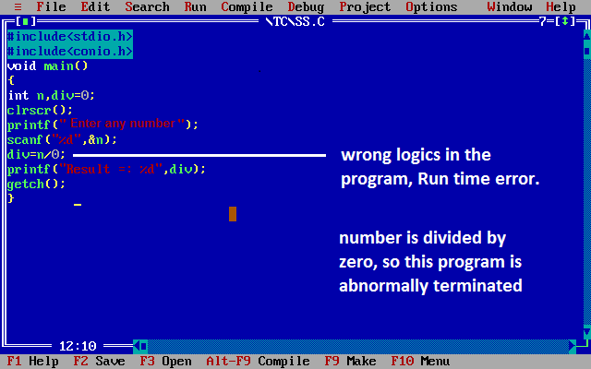

Slide 77
Runtime errors
Logical Errors :
The logical error is an error that leads to an undesired output. These errors produce the incorrect output, but they are error-free, known as logical errors.
These are one of the most common errors done by beginners of programming.
The occurrence of these errors mainly depends upon the logical thinking of the developer.
If the programmers sound logically good, then there will be fewer chances of these errors.

Slide 78
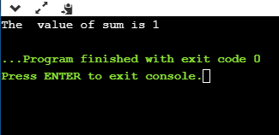
Runtime errors
Let's understand through an example.
#include <stdio.h>
int main()
{
int sum=0; // variable initialization
int k=1;
for(int i=1;i<=10;i++); // logical error, as we put the semicolon after loop
{
sum=sum+k;
k++;
}
printf("The value of sum is %d", sum);
return 0;
}
In the above code, we are trying to print the sum of 10 digits, but we got the wrong output as we put the semicolon (;) after the for loop, so the inner statements of the for loop will not execute. This produces the wrong output.

Slide 79
IDE
An IDE or integrated development environment is a software application that combines, in one place, all the tools needed for a software development Project.
An IDE or integrated development environment is an application or software which programmers use for programming.
an IDE is a handy piece of software that acts as a text editor, debugger, and compiler all in one. IDEs are designed to make coding easier for developers.
So basically, an IDE is an application that facilitates application development, and gives you a central interface featuring all the tools that developer needs.

Slide 80
IDE
IDE is that they offer a central interface with all the tools a developer needs, including:
Code editor: Designed for writing and editing source code, these editors are distinguished from text editors because work to either simplify or enhance the process of writing and editing of code for developers
Compiler: Compilers transform source code that is written in a human readable/writable language in a form that computers can execute.
Debugger: Debuggers are used during testing and can help developers debug their application programs.
Build automation tools: These can help automate developer tasks that are more common to save time.

Slide 81
Multi-Language IDE The multi-language IDEs – like Eclipse, Aptana, Komodo, NetBeans, and Geany – support multiple programming language
Eclipse: Supports C, C++, Perl, Python, Ruby, PHP, Java and others. It is a free and open source editor for many development frameworks. Although it began as a Java development environment, it has expanded through plugins. This IDE is managed and directed by the Eclipse.org Consortium.
NetBeans: Supports Java, PHP, JavaScript, C, C++, Python, Ruby, and more. It is also free and open source. Modules provide all functions of the IDE. Developers can add support for other programming languages by installing additional modules.
Komodo IDE: Supports Perl, PHP, Python, Tcl, JavaScript, Ruby, and more. This is an enterprise-level tool with a higher price point.
Aptana: Supports HTML, JavaScript, CSS, AJAX and others through plugins. It is a popular choice for programmers who do web app development.
Geany: Supports C, PHP, Java, HTML, Perl, Python, Pascal and many more.

Slide 82
IDE
Features of Multi-lang IDEs
Most multi-language IDEs have certain features in common that prove very useful when you're coding.
Intellisence – IDEs with this feature can provide code completion, quick info, and member lists on a project.
Smart code editing – your IDE can indent code lines, match words and brackets, and also highlight keywords.
Debugger – most IDEs provide powerful debugging features and along with a graphical debugger and breakpoints.
Extension/plugin manager – you can add new extensions/plugins to extend your IDE's functionality.
Version Control – IDEs offer support for various version control systems like Git, Subversion, Mercurial, CVS and so on.

Slide 83
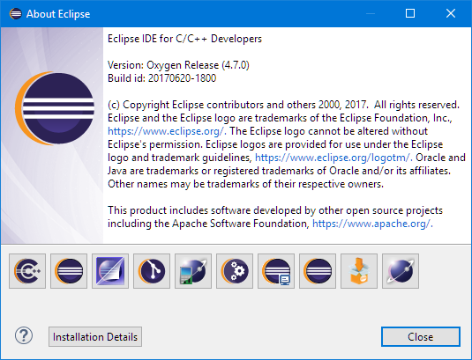

Slide 84
END OF UNIT 1

